Slide 1
P-Series Power Meter Firmware
Upgrade Process

Slide 2
Firmware Upgrade Flowchart
Step 1:
Motherboard Verification
Start
Check SN Prefix
>= “GB45” or “MY45” or “SG45”
NO
Check SN Prefix
>= “GB45” or “MY45” or “SG45”
Check Motherboard
Revision is “2”
Step 2:
Revision Conversion
YES
NO
Download
“Motherboard.exe”
to change Rev to “2”
Download
“Motherboard.exe”
to change Rev to “2”
NO
Return to service center for
motherboard upgrade
Check Motherboard
Revision is “2”
YES
Download firmware
from web and proceed
with firmware upgrade
Download firmware
from web and proceed
with firmware upgrade
YES
Step 3:
Firmware Upgrade

Slide 3

Step 1 : Motherboard Verification
It is important to verify the motherboard revision of the P-Series power meter before the firmware upgrade. This is due to the old version of motherboard on the earliest production batch are not able to support the new firmware.
The Steps for Verification (through power meter front panel)
Disconnect power sensor from the power meter.
Press [System], go to {Remote Interfaces}
Change GPIB Address to 13
Press [System], go to next screen page by pressing {2 of 2}
Go to {Service}
Then press {Version}
Verify the Serial Number and Motherboard Revision.
Notes:
It is important to verify the model of the motherboard on the P Series power meter before the installation of the new firmware. This is due to the fact that the old version of mother board on certain units of P Series are not able to support the new firmware features.
The above are 6 steps to verify the motherboard revision of the P-Series:
Select System
Select 2 of 2 – to move to the next screen
Select Service
Select Version
The last step, look for the revision of the motherboard. If the revision is 1 – the P Series needs to be send it for the upgrade of the motherboard. The upgrades is free. The firmware upgrades are not compatible with the Revision 1 motherboard. You may proceed to firmware upgrade for motherboard Revision 2.

Slide 4
Upgrade Conditions and Action
Step 1 : Motherboard Verification (Cont’)
 | Conditions | Action
1. | S/N: GB45xxxxxx or MY45xxxxxx or SG45xxxxxx Motherboard Rev: 2 | Proceed with firmware upgrade. Click here or proceed to page 7.
2. | S/N: GB45xxxxxx or MY45xxxxxx or SG45xxxxxx Motherboard Rev: 1 | Proceed to change Motherboard Revision to “2”. Click here or proceed to page 5.
3. | S/N: GB44xxxxxx or below | Contact Keysight Sales Representative to send the power meter back to the factory.

Slide 5
Hardware/Software Requirements
Step 2 : Revision Conversion
Note!!! Skip Step 2 if motherboard revision is “2”
The current hardware requirements for this procedure are:
(a) A PC running Windows 2000, Windows XP, Windows 7 or Windows 10.
(b) A GPIB interface card, or GPIB-USB interface.
The current software requirements for this procedure are:
(a) A VISA library (for example, Keysight IO Libraries).
(b) Motherboard revision conversion file “Motherboard.exe”
Note: This procedure has not been tested on other versions of Windows.

Slide 6
Step 2 : Revision Conversion (Cont’)
Obtaining The Software
    The latest version of the Keysight IO Libraries can be obtained from the following link:
    Keysight IO Libraries
    Motherboard revision conversion file “motherboard.exe” can be obtained from the following link:
    P-Series Firmware Upgrade
    Run the program to change the motherboard revision to “2”
    Go back to P-Series Motherboard Verification process.
Click on arrow!

Slide 7
Hardware/Software Requirements
Step 3 : Firmware Upgrade
The current hardware requirements for this procedure are:
(a) A PC running Windows 2000, Windows XP, Windows 7 or Windows 10.
(b) A GPIB interface card, LAN connection, or USB port.
The current software requirements for this procedure are:
(a) A VISA library (for example, Keysight IO Libraries).
(b) The P-Series Firmware Files for your instrument.
(c) The P-Series Firmware Upgrade Application (FwUpdateApp.exe).
Note: This procedure has not been tested on other versions of Windows.

Slide 8
Obtaining The Software
Step 3 : Firmware Upgrade (Cont’)
    The latest version of the Keysight IO Libraries can be obtained from the following link:
    Keysight IO Libraries
    The P-Series Firmware Upgrade Application can be obtained from the following link:
    P-series firmware upgrade
    Save the file to PC hard drive
    Note: This is a WinZip® executable file that must be unpacked before use.
    The P-series Firmware Upgrade Application is included in the WinZip® executable file (“FwUpdateApp.exe”)

Slide 9
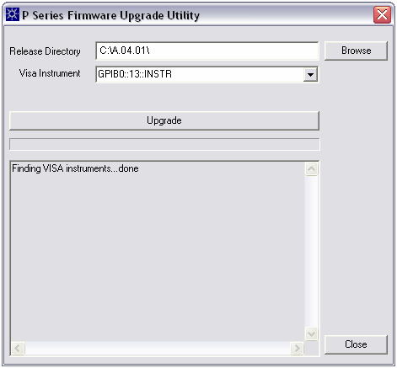
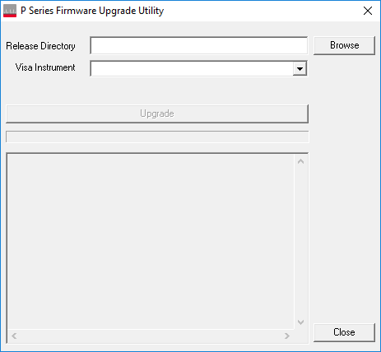
Firmware Upgrade Process
Latest Revision
GPIB Address
Step 1:
Run the ‘FwUpdateApp.exe’ application. This does not need to be installed – simply double-click on the file to run it.
Step 2:
Click on the ‘Browse’ button next to ‘Release Directory’, and select the directory
in which the firmware files reside.
Step 3:
Click on the drop-down arrow next to ‘VISA Instrument’, and select the unit to be
upgraded.
Note: This drop-down feature only works for upgrades over GPIB & USB. If the upgrade is being performed over LAN, then enter the IP address in this box.

Slide 10
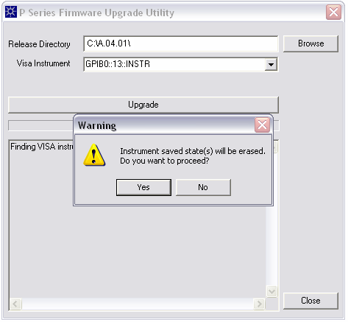
Firmware Upgrade Process
Step 4:
Click on the ‘Upgrade’ button.
Click ‘Yes’ on the warning pop-up when
asked about instrument saved states.

Slide 11
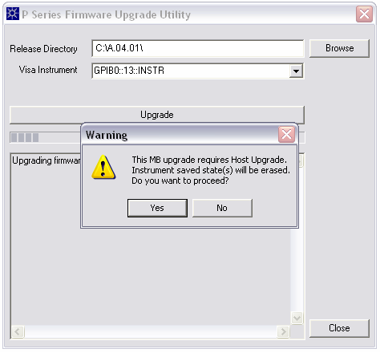
Firmware Upgrade Process
Step 5:
A warning message to notify the
instrument’s saved state(s) will be erased.
Click ‘Yes’ to proceed with the installation.

Slide 12
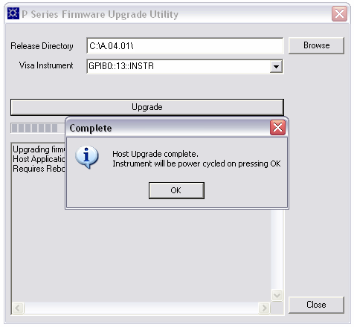
Firmware Upgrade Process
Step 6:
Click ‘OK’ on the pop-up that appears
when the upgrade is complete.
The power meter will take less than
5 minutes to complete the upgrade.
Now, the power meter will now
automatically execute a power cycle.
You have successfully upgrade the new firmware!

